Slide 1
Solutions
A Homogeneous Mixture that can be separated by physical means.

Slide 2
Solution Vocabulary
Solution – a homogeneous mixture that consists of:
Solute – substance that dissolves, present in lesser amount
Solvent – thing that does the dissolving, present in greatest amount.

Slide 3
Solubility Vocabulary
Electrolyte-any substance that contains ions that make the substance conduct electricity.
  Ex. Salt in water conducts
Non electrolyte – any substance that does not contain ions to make the substance conduct electricity.
  Ex. Sugar in water does not conduct

Slide 4
Solubility Vocabulary
Soluble – substance dissolves in solvent
  Ex. Sugar is soluble in water
Insoluble – substance does not dissolve in solvent
  Ex. Sand is insoluble in water

Slide 5
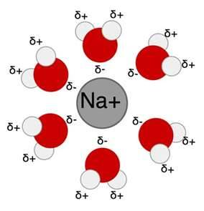
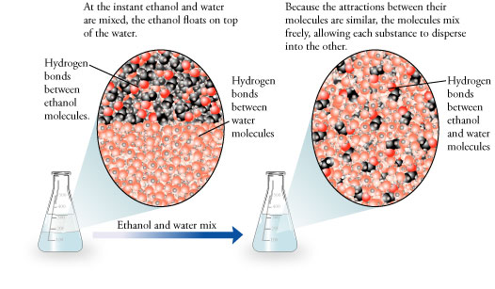
More terms
Dissolving- a solvent
surrounds a solute.
Miscible- two liquids mixing

Slide 6
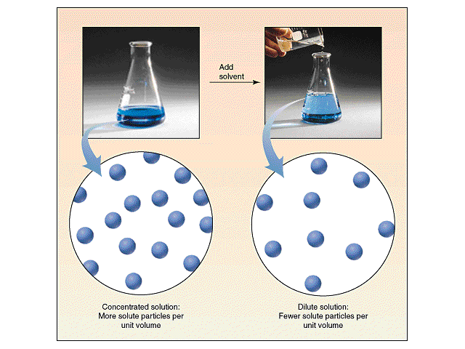
Concentration is the amount of solute dissolved in a given amount of solvent.
Concentrated
Dilute
More solute particles per unit volume
Fewer solute particles per unit volume

Slide 7
Solution Types
Depend on the state of solvent
Solvent is Gas – ex. Air – Nitrogen gas is the solvent
Solvent is Liquid – water is the most common solvent; ex. Sugar water, water is the solvent
Solvent is Solid – ex. Nitrinol, titanium dissolved in nickel, used to make braces

Slide 8


Water is the Universal Solvent
Because it is polar
No polar like this
It can dissolve many different substances.

Slide 9
Dissolving results when water interacts with the solute.
Watch this:
Your body relies on water to dissolve the molecules in your body.

Slide 10
Solubility
Maximum amount of solute that will dissolve in a given amount of solvent at a given temp & pressure; expressed as grams of solute per 100 g of solvent.
Change the temperature or pressure and the solubility changes.

Slide 11
Ways to Increase Solubility
Solid Solute
Increase temperature of solvent
Increase surface are of solute
Stir (agitate)
Pressure has no effect
Gas Solute
Decrease temperature of solvent
Increase pressure
Surface area of solute has no effect

Slide 12
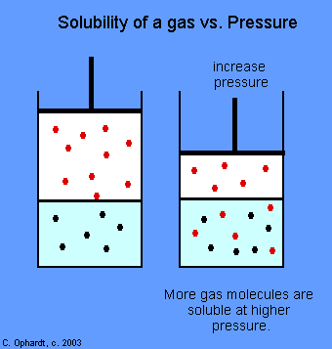
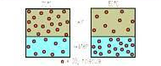
Gas Solubility is different
Want it to dissolve?
High Temp Low Temp
You want more gas particles in the liquid

Slide 13
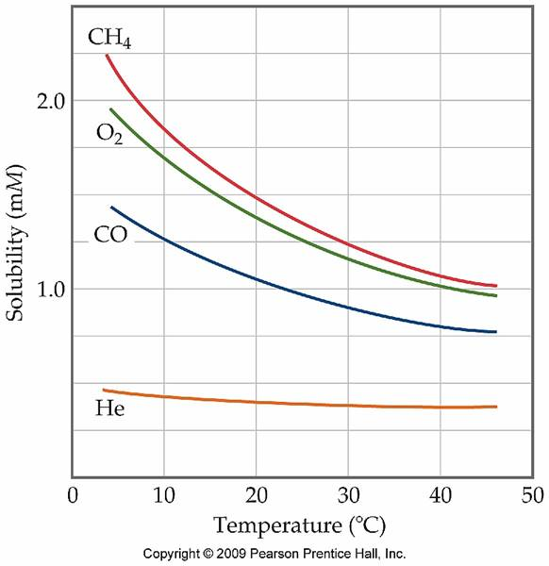
Gas solubility and temperature is INDIRECT

Slide 14
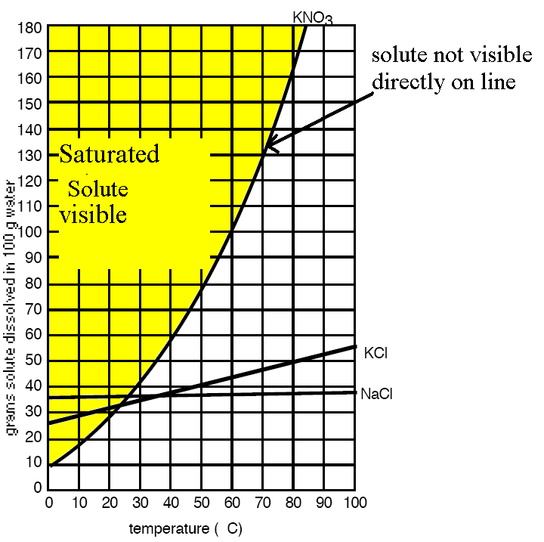
Saturated Solution
  solution that contains the maximum amount of dissolved solute for a given amount of solvent at a specific temp and pressure.
  You must see undissolved solute on the bottom of the container.

Slide 15
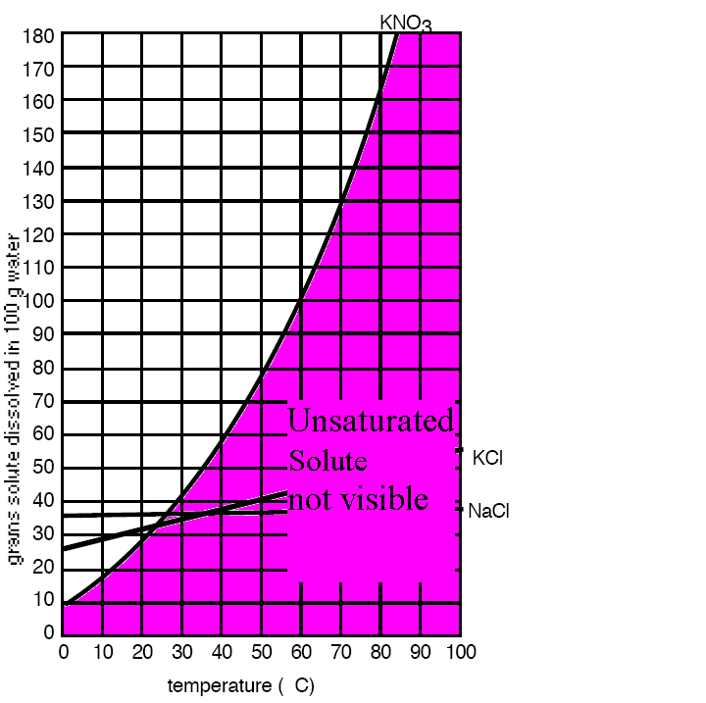
Unsaturated Solution
solution that contains less dissolved solute for a given temp and pressure than a saturated solution
Below saturated line

Slide 16
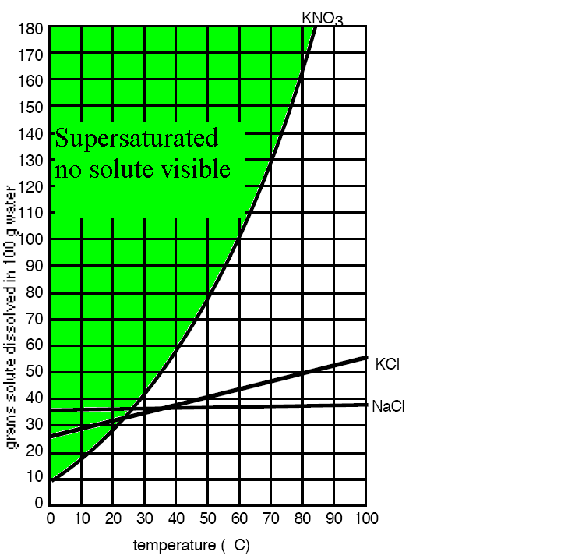
Supersaturated Solution
  solution which contains more dissolved solute than a saturated solution at the same temp. Under special conditions such has heating and then cooling.
  Above saturated line

Slide 17
Molarity
A unit of concentration The number of moles of solute dissolved in 1.00 L of solution.
Molarity (M) = Moles of solute
Liter of solution

Slide 18
Practice Problem
What is the molarity if 2.0 moles of glucose are added to 5.0 L of solution?

Slide 19
Practice Problem
Molarity (M) = Moles of solute Liter of solution
2.0 moles =.40 M
5.0 L

Slide 20
Solution Dilution
To make a concentrated solution more dilute use this formula
M₁V₁ = M₂V₂
M₁ = concentrated solution
V₁ = amount of concentrated solution need to make dilute solution
M₂= dilute solution
V₂ – amount of diluted solution wanted.

Slide 21
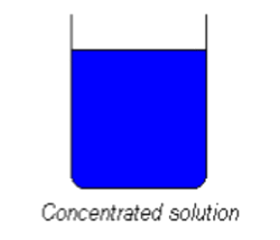
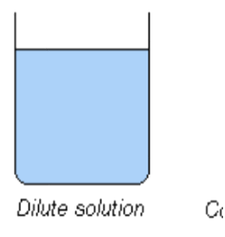
Practice
How many liters of 16.8M HCl is need to make 2.5L of 3.5M HCl?

Slide 22
Dalton’s Law
Dalton’s Law of Partial Pressure – at constant volume & temperature, the total pressure exerted by a mixture of gases is equal to the sum of the partial pressures.
Total pressure = P gas1 + P gas2 + Pgas3….
P_{total} = P₁ + P₂ + P₃….

Slide 23
Dalton’s Law
Sample:
What is the pressure of hydrogen in atm if it is mixed with oxygen which exerts a pressure of 2.1 atm and the total pressure is 3.6 atm?

Slide 24
Dalton’s Law
What is the pressure of hydrogen in atm if it is mixed with oxygen which exerts a pressure of 2.1 atm and the total pressure is 3.6 atm?
PH₂ = P_{Total} – PO₂
PH₂ = 3.6 atm – 2.1 atm
= 1.5 atm

Slide 25
Dalton’s Law
Standard Deviants

